Slide 1
Zeno E-Hailing App
PRESENTED BY
DEZGN STUDIO TECH SDN BHD

Slide 2
Reimagining Grab
Building a vertically integrated Transportation "Super App" that goes beyond simple ride-hailing.
This project is designed to build a self-sustaining ecosystem where the platform controls not just the ride (Passenger/Driver matching), but also the assets (Vehicles) and the money (Financial Services).

Slide 3
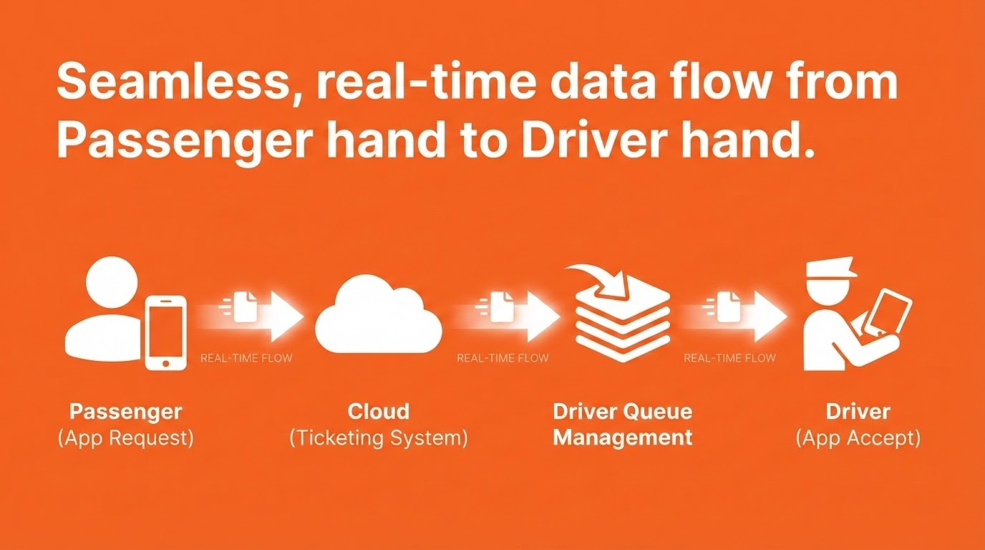

Slide 4
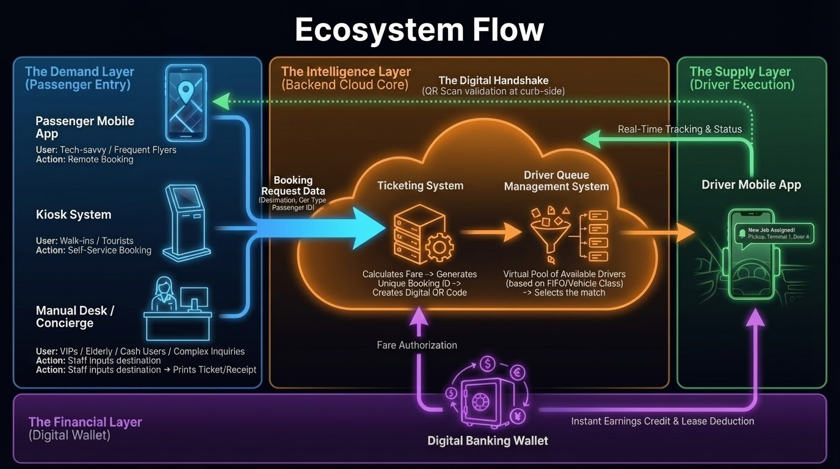

Slide 5
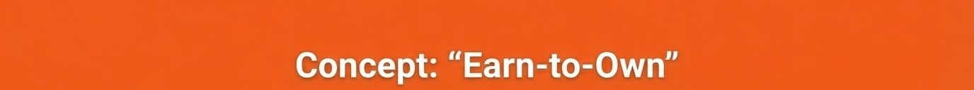
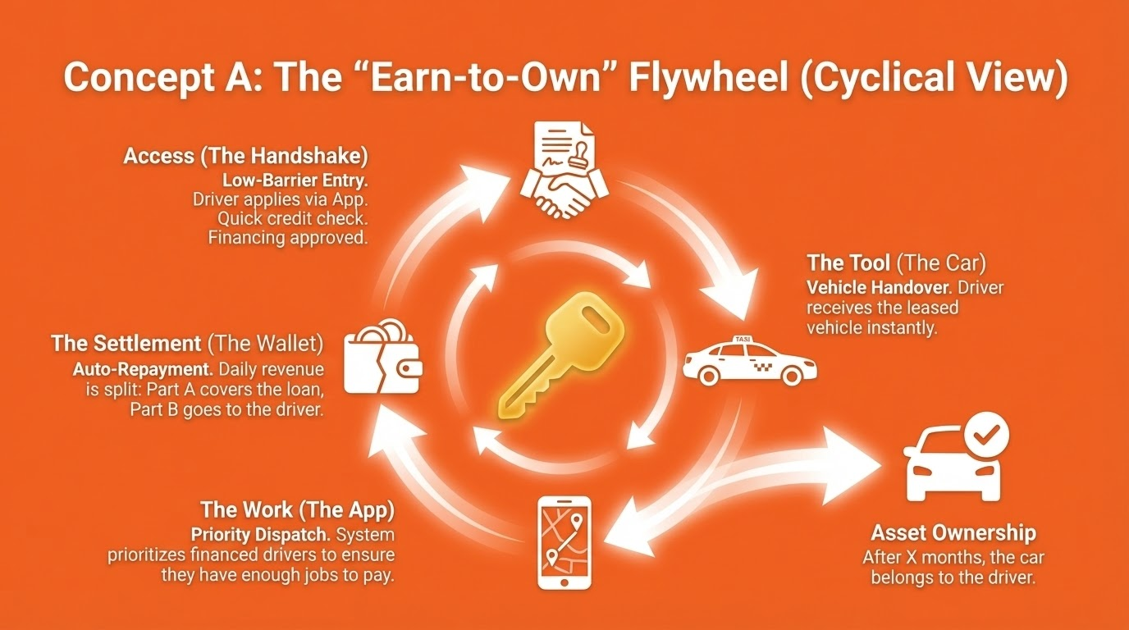

Slide 6
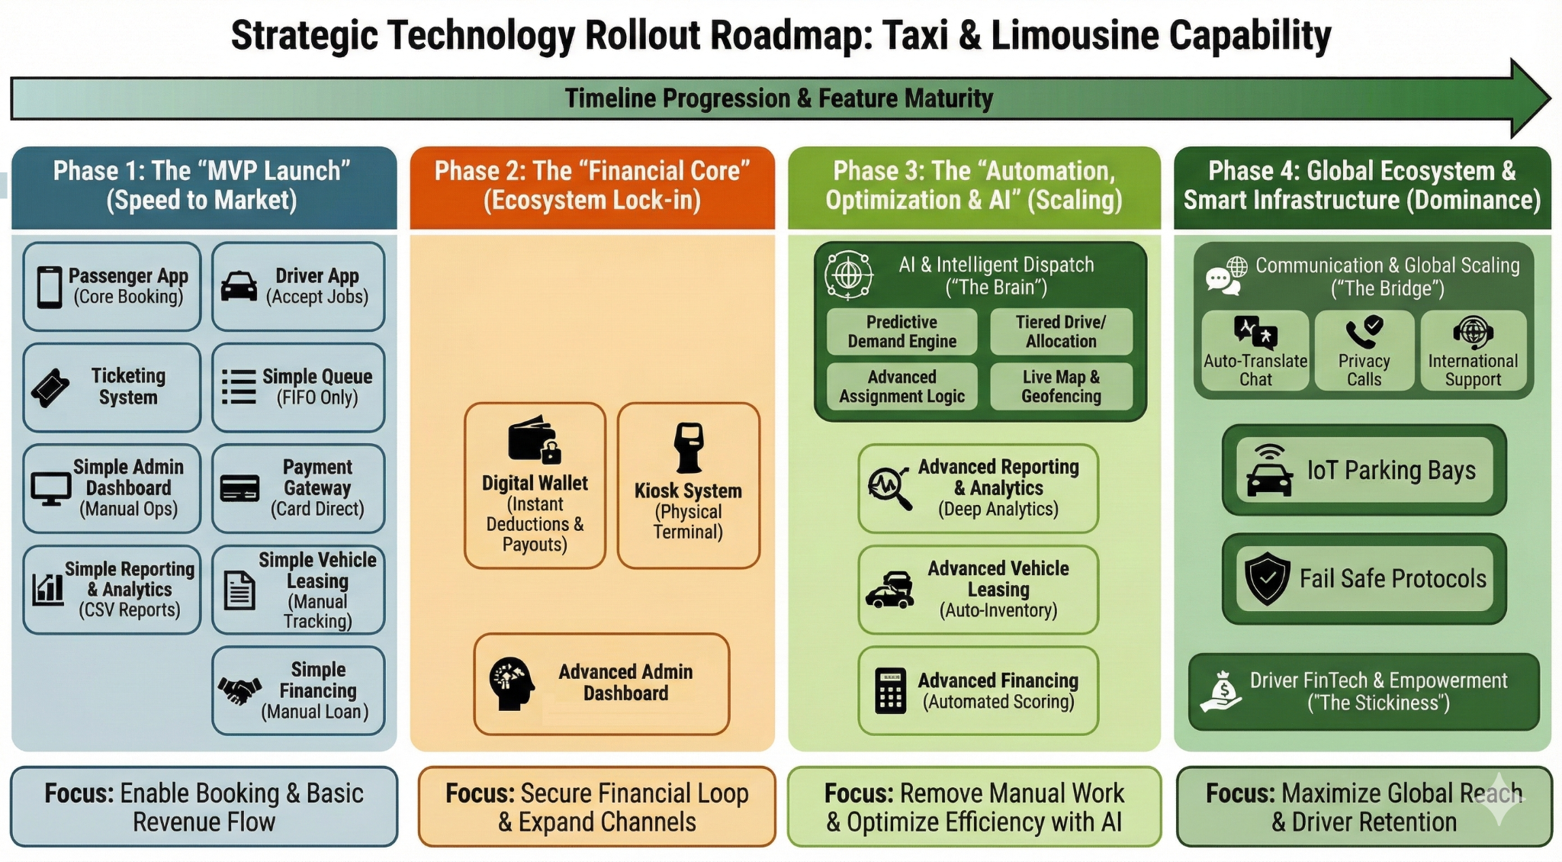

Slide 7
TIMELINE
Phase 1 ( 3 mth)
Passenger App
Ticketing System
Driver Queue Management
Driver App
Payment Gateway
Basic Admin Panel
Basic Reporting System
Phase 3 ( 3 mth)
Advance Driver Queue
Reporting & Analytics
Vehicle Leasing Module
Financing Module
Aug 2026
Feb 2026
Nov 2026
Jan 2026
May 2026
Phase 4 ( 3 mth)
Fail-Safe Protocol
Driver FinTech& Empowerment
Communication & Global Access
IOT Parking Bays
Load Testing Plan
Automated Testing
Disaster Recovery Plan
Design Phase
Front End
UI/UX
Phase 2 ( 3 mth)
Digital Wallet
Kiosk System
Advance Admin Dashboard
Driver App

Slide 8
Phase 1
(Month 1-3, Speed to Market)
Passenger App (RM 59,000)
Ticketing System (RM 40,000)
Driver Queue Management (RM 29,000)
Driver App (RM 39,000)
Payment Gateway (RM 10,000)
Basic Admin, Basic Reporting, Basic Vehicle Leasing, Basic Financing (RM20,000)
Total: RM 197,000

Slide 9


1. Passenger App (RM 59,000)
1. User Onboarding:
Mobile Number Auth: OTP login (fastest onboarding).
Profile Creation: Name, Email (for receipts), Language preference.
2. Booking Workflow
Service Selection: Choose between Taxi (Budget/Exec) or Limo.
Fare Estimation: View fixed price or estimated meter range based on destination.
3. Active Trip Management:
Digital Ticket: Generates a dynamic QR code containing the Booking ID and Destination.
Driver Matching: Push notification when a driver is assigned.

Slide 10
1. Passenger App (RM 59,000)
4. Location Services
Live Tracking: See driver location and ETA (if applicable).
Ride Sharing: "Share my ride" link for safety.
5. Trip Receipts
Auto-generated after trip completion
Stored in app
PDF export option
6. Rating & Review
Rate driver/vehicle cleanliness.

Slide 11
2. Ticketing System (RM 39,000)
1. Fare Engine:
Dynamic Pricing Rules with AI: Configure base fare, distance rates, time rates, and surcharges (e.g., Midnight surcharge, Airport toll).
Zone Management: Define geofenced zones (e.g., Zone A flat rate vs. Zone B metered).
2. Ticket Lifecycle Management:
Status Tracking: Created → Paid → Assigned → Active → Completed/Cancelled.
Validation: API to validate QR codes scanned by drivers or attendants.
3. Settlement Engine:
Split Payments: Automatically calculate the split between Driver Share, Platform Fee, and Airport/Mall Levy.

Slide 12
2. Ticketing System (RM 39,000)
4. Transaction Logging
For audits and LHDN/e-invoice compatibility:
Ticket info
Payment method
Driver earning
Time of every event

Slide 13
3. Driver Queue Management (RM 29,000)
1. Simple Geo-Fencing
Drivers must be physically present in the allowed zone:
5km radius within the area
2. Queue Categories
Drivers join the correct queue:
Budget Taxi
Premier Taxi
Limo
MPV

Slide 14
3. Driver Queue Management (RM 29,000)
3. Auto Dispatch
When a passenger books a ticket:
System assigns the first driver in queue
If declined, driver is pushed to bottom
Ensures fairness to all drivers

Slide 15
4. Driver App (RM 39,000)
1. Queue System UI
Drivers can:
Join queue
Leave queue
See position
Receive assignment
2. Job Assignment
Driver receives job card
Accept/Reject
See passenger QR for verification

Slide 16
4. Driver App (RM 39,000)
3. Ticket & History
List of completed jobs
Earning history per job
Disputes submission
4. Compliance & Documentation
Upload driving license
Vehicle permit
Insurance
Road tax
Renewals reminders

Slide 17
5. Payment Gateway (RM 10,000)
1. Payment Options
Digital wallet (balance)
Debit/Credit card
FPX
Optional: Apple Pay / Google Pay

Slide 18
6. Basic Admin (RM 5,000)
1. Ticketing Console (Integrated Google Sheets)
View real-time tickets
Edit ticket status
Refund approval
2. Queue Monitoring (Integrated Google Sheets)
Live queue view
Driver behaviour logs
History, disputes, penalties
3. Driver & Vehicle Management (Integrated Google Form + Google Sheets)
KYC
Permit validity
Vehicle assignment

Slide 19
7. Basic Reporting (RM 5,000)
1. Revenue Analytics (Integrated Google Sheets)
Per ticket type
Per channel (app/kiosk/counter)
Per location (airport/mall)
2. Driver Performance (Integrated Google Sheets)
Completed trips
Acceptance rate
Overdue payment alerts

Slide 20
8. Basic Vehicle Leasing (RM 5,000)
1. Rental Plans (Integrated Google Forms)
Daily
Weekly
Monthly
Rent-to-own
2. Vehicle Inventory (Integrated Google Forms)
Tracks:
Car availability
Car condition
Mileage logs
Maintenance schedule

Slide 21
9. Basic Financing (RM 5,000)
1. Loan Applications (Integrated Google Sheets)
Drivers apply for:
Personal loan
Company loan
Rent-to-own
2. KYC & Document Submission (Integrated Google Sheets)
Payslips
IC
Bank statements

Slide 22
Phase 2
(Month 3-6, Ecosystem Lock-in)
Digital Wallet (RM 80,000 + RM 40,000 Security Audit)
Kiosk System (RM 60,000)
Admin Dashboard (RM 25,000)
Total: RM 205,000

Slide 23
1. Digital Wallet (RM120,000)
1. Wallet Top-Up
FPX
Credit/Debit card
Kiosk (cash)
Counter (cash)
2. Auto-Deductions
System auto-deducts:
Vehicle rental
Loan instalments
System service fees
Penalties

Slide 24
1. Digital Wallet (RM120,000)
3. Driver Payouts
Ticket revenue is credited instantly:
Every completed job
Summary at end of day
4. Ledger & Statements
Full statement
Transaction tags
Export to PDF
Tax reporting
Security Audit (Price Estimated RM40,000)

Slide 25
2. Kiosk System (RM60,000)
1. Ticket Purchase
Select vehicle type
Payment
Print QR ticket
2. Payment Methods
Cash
Credit/Debit
QR pay (TNG, Boost, GrabPay)
FPX

Slide 26
2. Kiosk System (RM60,000)
3. Wallet Top-Up
Cash-based top-up is important for foreign tourists.
4. Hardware Capabilities
Touchscreen
Thermal printer
Cash acceptor
QR scanner

Slide 27
3. Admin Dashboard (RM25,000)
1. Ticketing Console
View real-time tickets
Edit ticket status
Refund approval
2. Queue Monitoring
Live queue view
Driver behaviour logs
History, disputes, penalties
3. Driver & Vehicle Management
KYC
Permit validity
Vehicle assignment

Slide 28
2. Admin Dashboard (RM25,000)
4. Admin Controls
Add/remove drivers
Force requeue
Suspend for infractions
Manual assign (SOS situations)
5. Wallet Admin
Adjust wallet balance
Manual credit/debit
Suspicious activity alerts

Slide 29
Phase 3
(Month 7-9, Scaling)
Advanced Driver Queue (AI Dispatch) (RM 90,000)
Reporting & Analytics (RM25,000)
Vehicle Leasing Module (RM40,000)
Financing Module (RM40,000)
Total: RM 195,000

Slide 30
1. Advanced Driver Queue/AI (RM 90,000)
1. Driver Check-In (Geo-Fenced)
Drivers must be physically present in the allowed zone:
Airport holding area
Hotel taxi zone
Mall basement queue spot
GPS + QR sign-in prevents cheating.
2. Real-Time Queue Visibility
Drivers see:
Current position
Estimated time
Cars ahead
Cars behind

Slide 31
1. Advanced Driver Queue (RM 90,000)
3. Tiered Driver Allocation
Premium Tier: Drivers with 4.8+ rating, <5 min response guarantee.
Standard Tier: Regular verified drivers.
Reserve Pool: 20% buffer of drivers always on standby.
Predictive Demand Engine
Machine learning predicting demand 30-60 minutes ahead.
Pre-position drivers in high-demand zones.
Dynamic pricing to maintain availability.
Advanced Assignment Logic
Multi-Assignment: Each driver receives 1-3 optimized trip suggestions.
Cascading Assignment: 15-second auto-accept logic across tiers.
Live Map: Visualization of actual available drivers (real-time data).

Slide 32
2. Reporting & Analytics (RM25,000)
1. Revenue Analytics
Per ticket type
Per channel (app/kiosk/counter)
Per location (airport/mall)
2. Queue Performance
Average waiting time
Peak demand hours
Driver compliance rate
3. Driver Performance
Completed trips
Acceptance rate
Overdue payment alerts

Slide 33
2. Reporting & Analytics (RM25,000)
4. Wallet & Finance
Cashflow statements
Top-up methods
Withdrawal patterns

Slide 34
3. Vehicle Leasing Module (RM40,000)
1. Rental Plans
Daily
Weekly
Monthly
Rent-to-own
2. Vehicle Inventory
Tracks:
Car availability
Car condition
Mileage logs
Maintenance schedule

Slide 35
3. Vehicle Leasing Module (RM40,000)
3. Rental Contracts
Digital signing
Wallet auto-deductions
Contract reminders
4. Damage Reporting
Photo evidence
Repair workflow
Expense allocation to driver

Slide 36
4. Financing Module (RM40,000)
1. Loan Applications
Drivers apply for:
Personal loan
Company loan
Rent-to-own
2. KYC & Document Submission
Payslips
IC
Bank statements

Slide 37
4. Financing Module (RM40,000)
3. Repayment Engine
Auto schedule generation
Wallet auto-deduction
Penalty charges
4. Loan Dashboard
Admin can:
Approve loans
Track repayment
Flag defaults

Slide 38
Phase 4
(Month 9-12, Dominance)
Fail-Safe Protocols (RM 25,000)
Driver FinTech & Empowerment (RM75,000)
Communication & Global Access (RM50,000)
IoT Parking Bays (60,000)
Total: RM 210,000

Slide 39
1. Fail-Safe Protocols (RM25,000)
Fail-Safe Protocols
Backup Vehicle: Automatic reassignment within 60 seconds of a cancellation.
Cross-Service Backup: If no e-hailing is available, auto-suggest nearby Taxis, Rent-a-Car, or Limos.

Slide 40
2. Driver FinTech & Empowerment (RM75,000)
Earnings Optimization
Heat maps with predicted surge zones.
Trip preferences (filtering for airport runs, long trips, etc.).
Gamification: Package deals (e.g., "Complete 15 rides, get bonus + priority assignment").
Financial Ecosystem
Instant Cash-out: Transfer earnings to bank account immediately.
Micro-loans: Credit for vehicle maintenance or fuel.
Insurance Products: Integrated trip, vehicle, and medical coverage.
Community
Driver community support forums/groups.

Slide 41
3. Communication & Global Access (RM50,000)
Global Accessibility
International phone number/login support (for tourists).
Auto-translate for driver-customer chat.
Translated App
Live Communication
Privacy-Protected: Direct voice/video call with customer (masking phone numbers).
Support: Operator hotline with 90-second response guarantee.

Slide 42
4. IoT Parking Bays (60,000)
1. Smart Parking Bays (IoT Sensors)
Each bay has:
Ultrasonic / LiDAR sensor to detect if a car is present
Indicator light (green = free, red = assigned)
Sensors send real-time data to the platform.
2. Bay Assignment Engine
When a driver joins the queue, the system:
Assigns an available bay
Sends the bay number to the driver app
Updates bay to reserved
If driver moves to wrong bay → violation alert

Slide 43
4. IoT Parking Bays (60,000)
3. Driver App Integration
The Driver App displays:
Assigned bay number
4. Real-Time Bay Dashboard (Admin Panel)
Admins see:
List of parking bays
Occupancy status (Free / Reserved / Taken)
Driver ID inside each bay
Violations (wrong bay, no show, early exit)
Total available bays

Slide 44
Load Testing Plan
Use JMeter to run load testing
Create a pre-production environment to run the load testing on
Park load testing under the regression testing
During the loading testing, monitor:
DB downtime
API response times
Backend pod/node Management

Slide 45
Automated Testing (Reliability)
Introduce regression testing
Automated QA testing (Price TBC)
Backup data on to a Read-Only database on an arbitrary time.
Create system alerts
Downtime
P0 errors, i.e. payment errors, user login errors
Feature flags when introducing new stories and work
Create autoscaling rules based on usage
Have a caching layer to prevent over access into db

Slide 46
Disaster Recovery Plan
Introduce:
Multi-Availability Zone (Price TBC)
Data Replication (Price TBC)

Slide 47
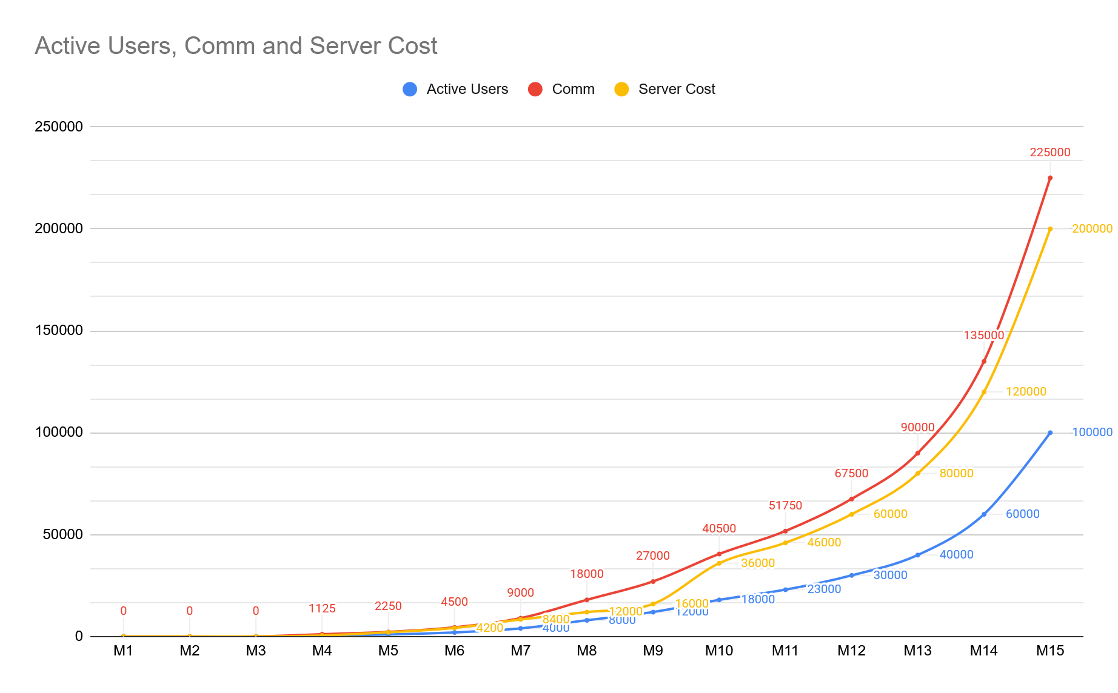

Slide 48
